Slide 1
Final Project
Visual Question & Answering Model
Saja Abdullah

Slide 2
Table of contents
1
2
3
4
Previous Work “Story Teller AI Models”
Final Project “Visual Question & Answering Model”
Arabic language problems
GitHub repository & Hugging Face space

Slide 3
1
Previous Work, “Story Teller AI Models”

Slide 4
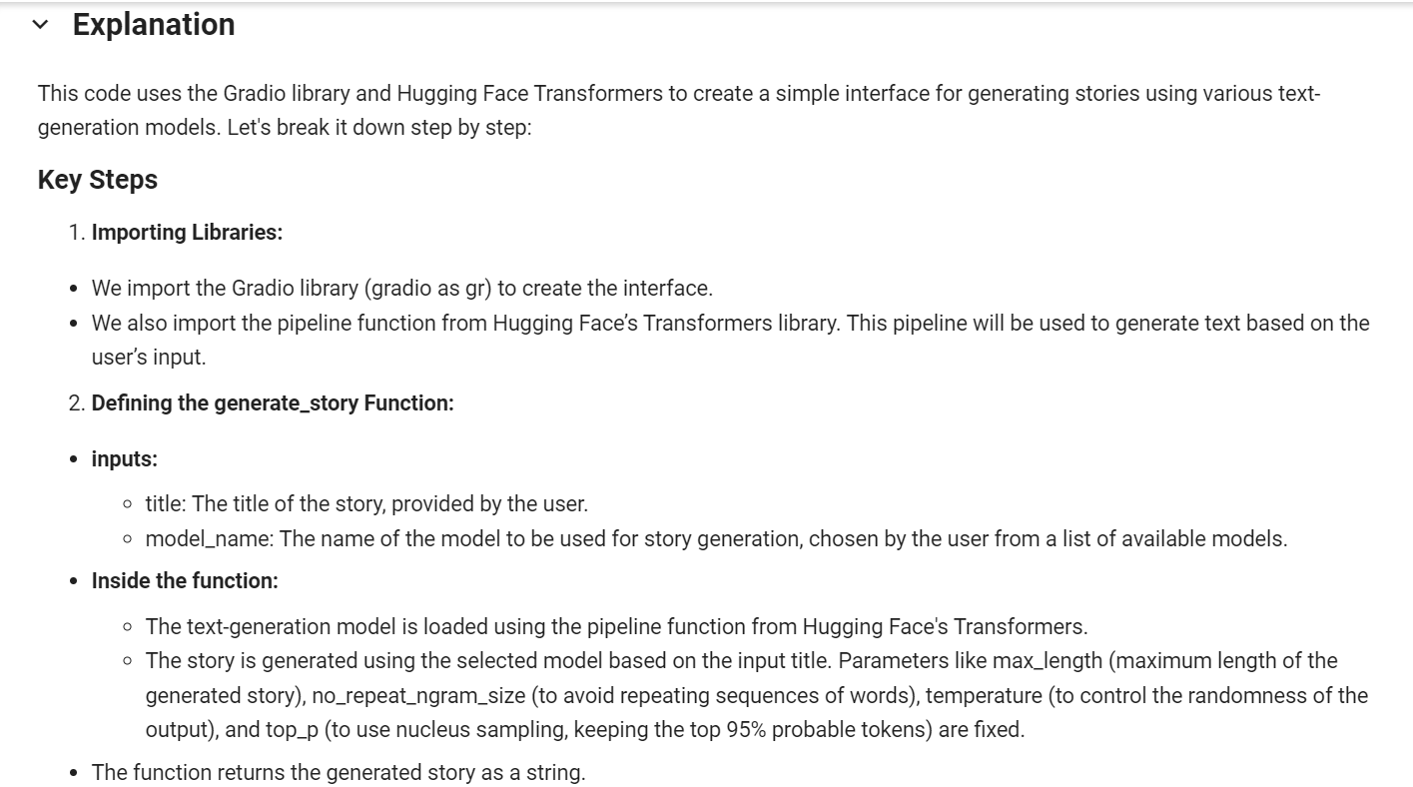
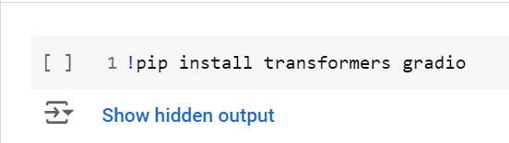
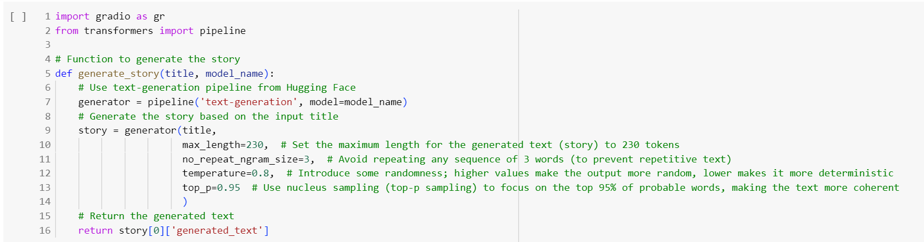
Screenshot of The Code:

Slide 5
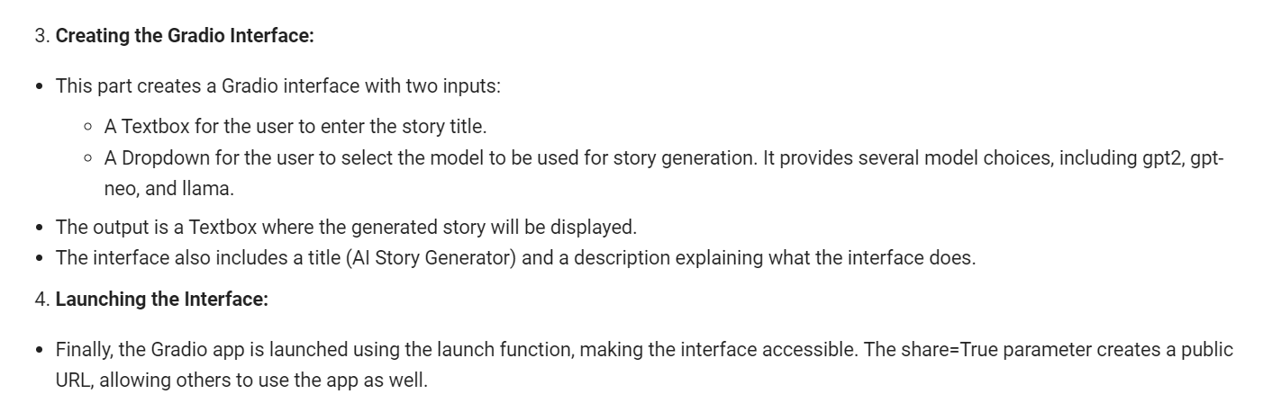
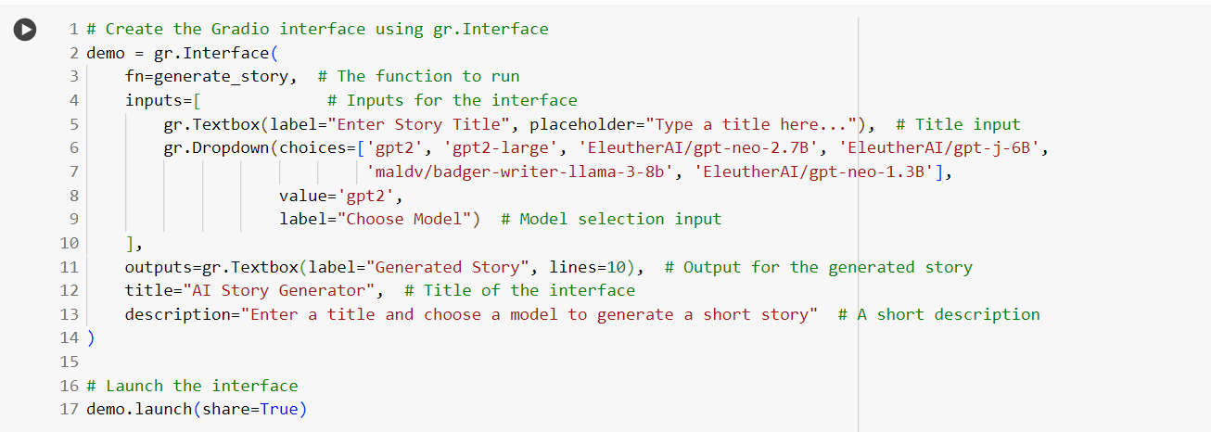
Screenshot of The Code:

Slide 6
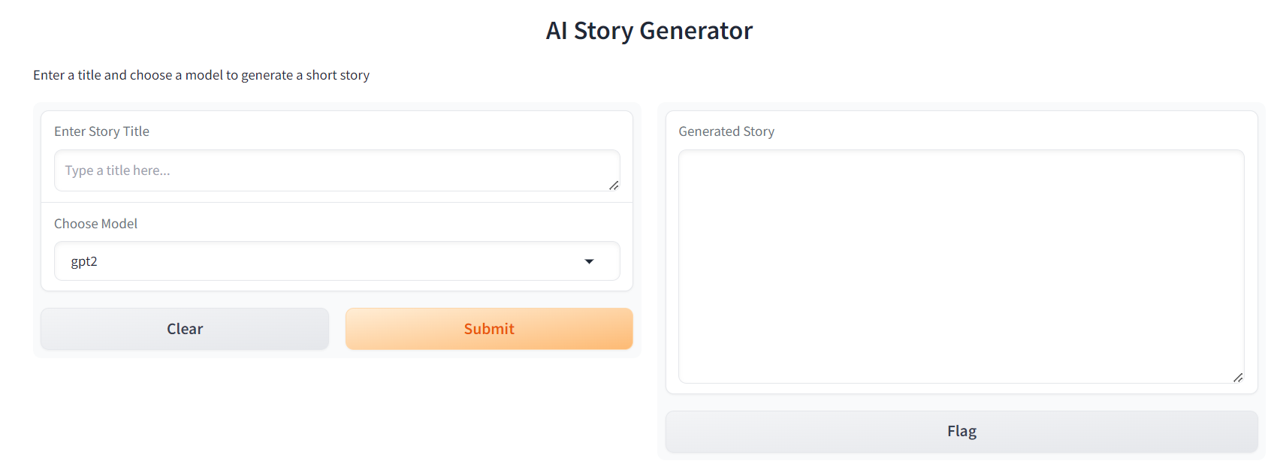
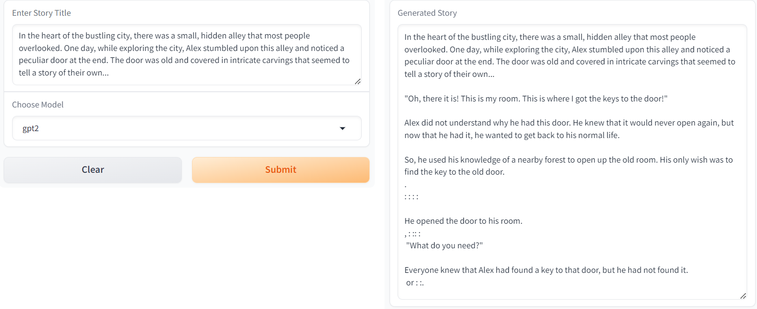
Screenshot of the Outputs:

Slide 7
2
Visual Question & Answering Model

Slide 8
The "VQA-with-Audio using BLIP and Gradio" project aims to create an interactive application that allows users to ask questions about an uploaded image and receive audio responses. By using Hugging Face's BLIP model and a simple Gradio interface, the application makes it easy for users to interact with images and receive spoken answers, enhancing accessibility and engagement.

Slide 9
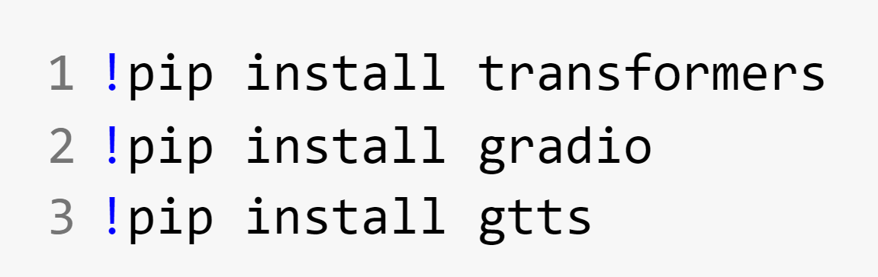
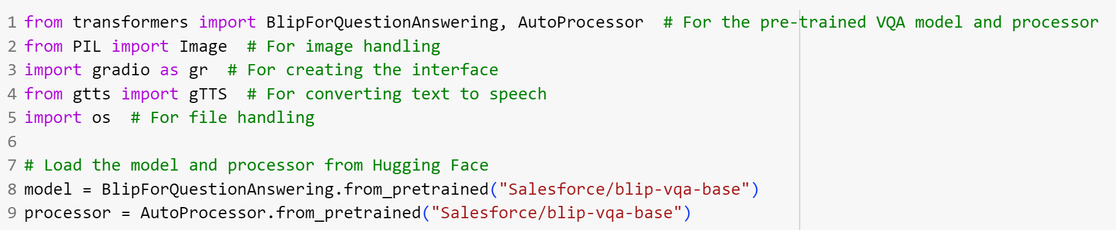
Screenshot of The Code:

Slide 10
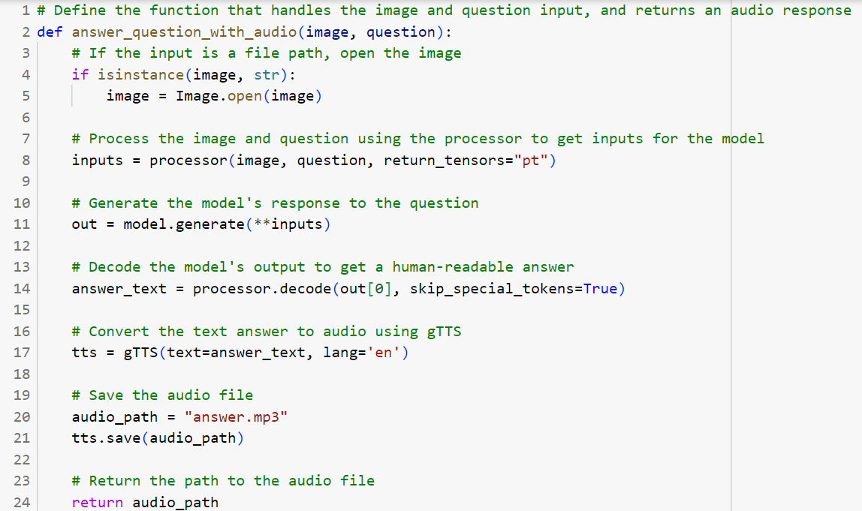
Screenshot of The Code:

Slide 11
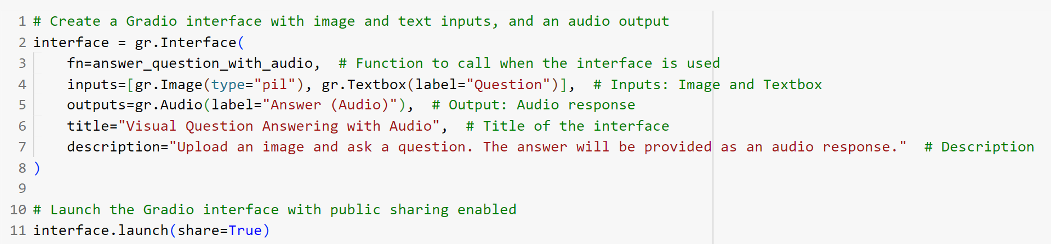
Screenshot of The Code:

Slide 12
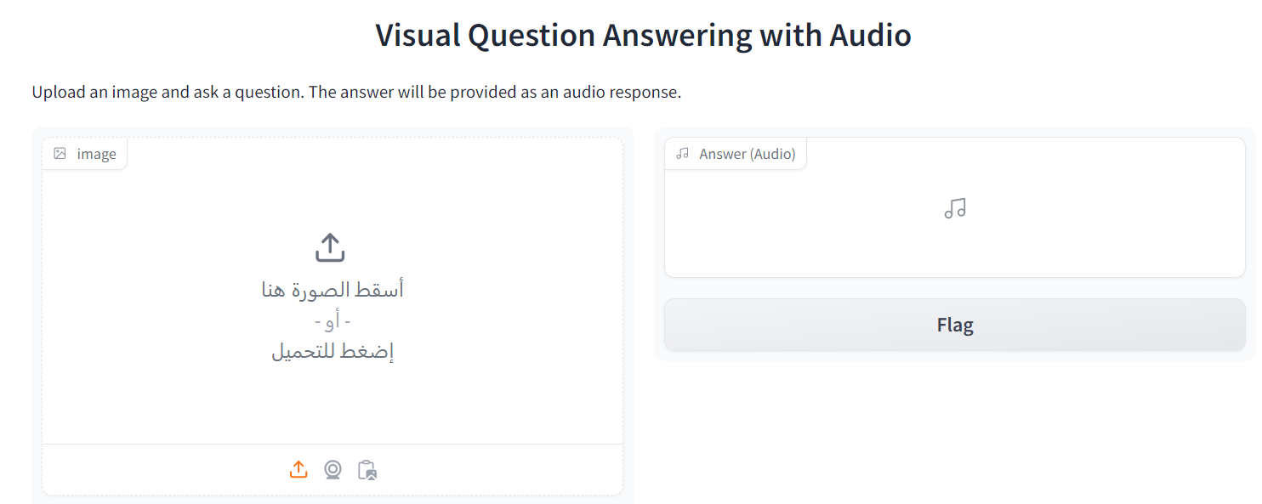

Screenshot of the Outputs:

Slide 13
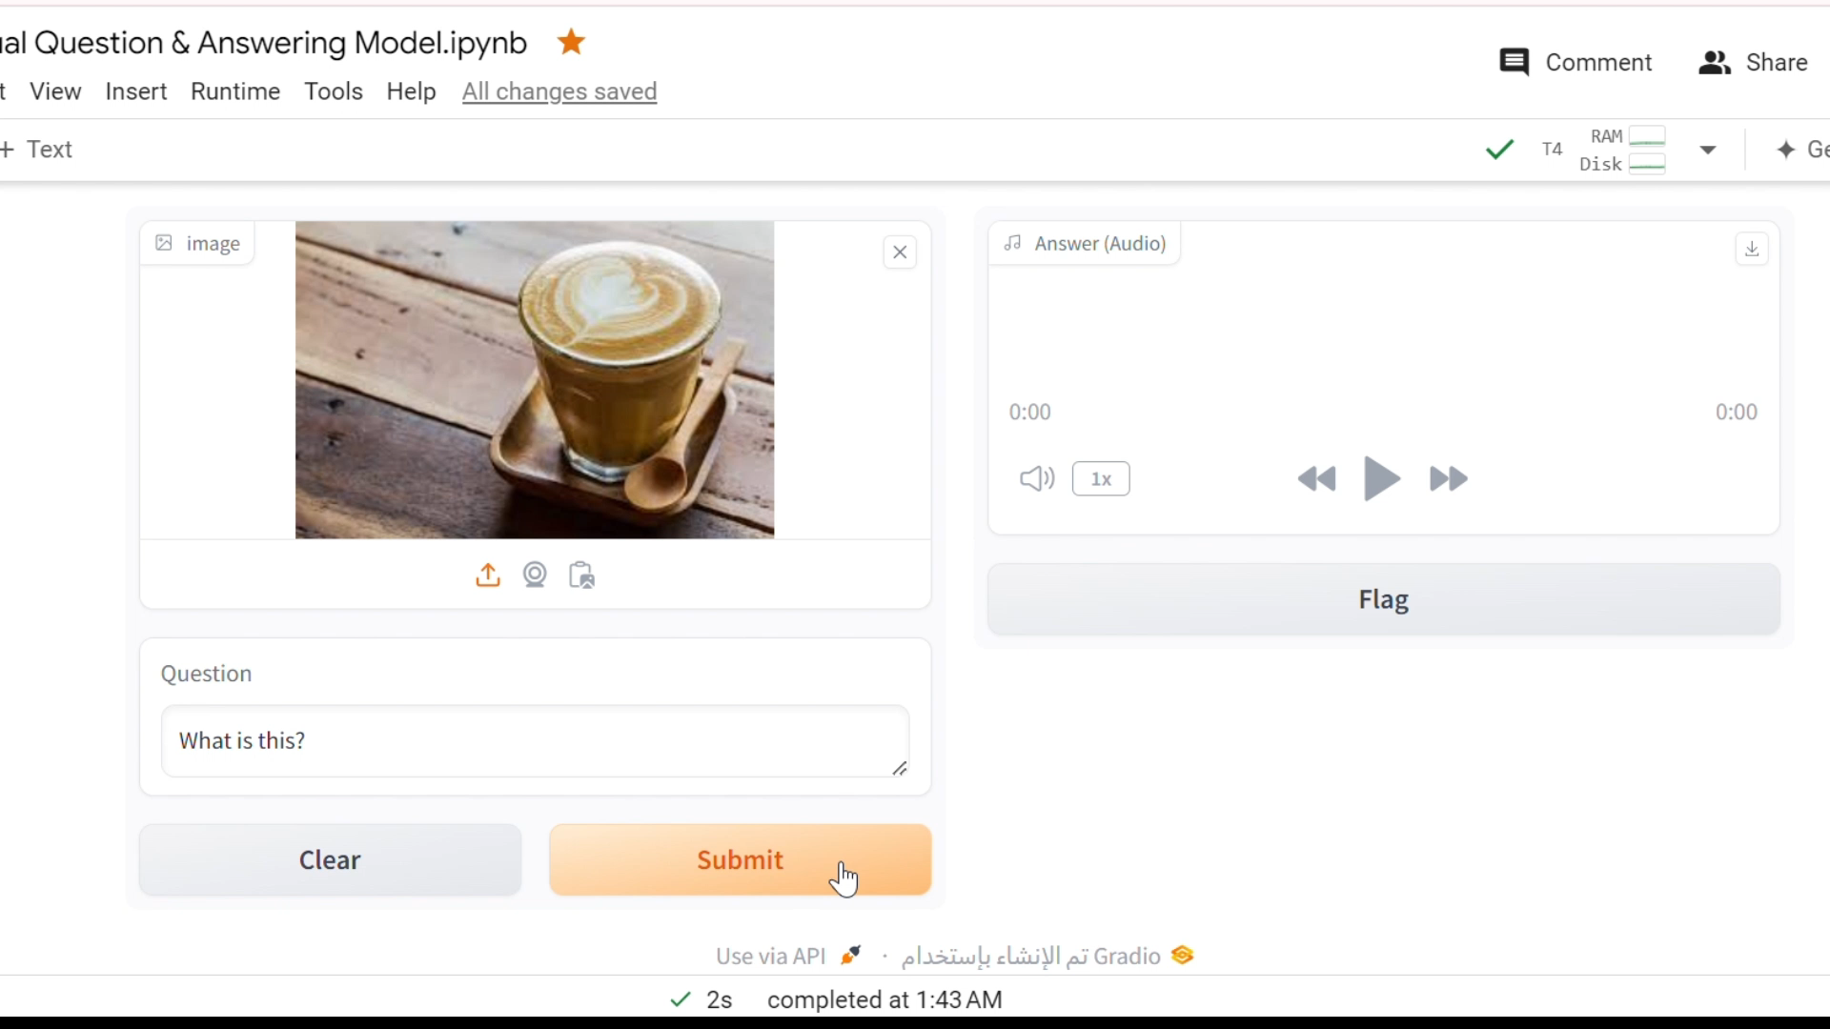

Slide 14
3
Arabic language problems

Slide 15
After research, it was found that there are significant limitations in available VQ&A models for Arabic. Models like BLIP are designed for English, and there are no equivalent Arabic models with the same capabilities. Moreover, datasets for this task are mainly in English, and developing an Arabic model from scratch would require extensive resources, which are beyond the project’s scope. Hence, using the English model is more feasible.
???

Slide 16
04
GitHub repository & Hugging Face space

Slide 17
GitHub repository:
https://github.com/IS-Saja/VQA-with-Audio
Hugging Face space:
https://huggingface.co/spaces/saja003/VQA-with-Audio

Slide 18
Thanks!

